Slide 1
Lecture
The Business Model Canvas

Slide 2
What is Business Model Canvas?
UECS3393 Software Entrepreneurship
A business model is simply a plan describing how a business intends to make money.
It explains who your customer base is and how you deliver value to them and the related details of financing.
the business model canvas lets you define these different components on a single page.
The business model canvas is a strategic management tool that lets you visualize and assess your business idea or concept.
It’s a one-page document containing nine boxes that represent different fundamental elements of a business.
The business model canvas beats the traditional business plan that spans across several pages, by offering a much easier way to understand the different core elements of a business.
UTAR - LKC FES DIECS|

Slide 3
Why You Need a Business Model Canvas?
UECS3393 Software Entrepreneurship
The BMC provides a quick overview of the business model and is devoid of the unnecessary details compared to the traditional business plan.
The visual nature of the business model canvas makes it easier to refer to and understand by anyone.
It’s easier to edit and it can be easily shared with employees and stakeholders.
The business model canvas can be used by large corporations as well as startups with just a few employees.
It clarifies how different aspects of the business are related to each other.
You can use a BMC template to guide a brainstorming session on defining your business model effectively.
UTAR - LKC FES DIECS|

Slide 4
How to Make a Business Model Canvas?
UECS3393 Software Entrepreneurship
There are 9 building blocks in the business model canvas:
Customer value proposition,
Customer segments,
Channels,
Customer relationships,
Revenue streams,
Key resources,
Key partners,
Key activities,
Cost structure.
When filling out a business model canvas, you will brainstorm and conduct research on each of these elements. The data you collect can be placed in each relevant section of the canvas. So have a business model canvas ready when you start the exercise.
UTAR - LKC FES DIECS|

Slide 5
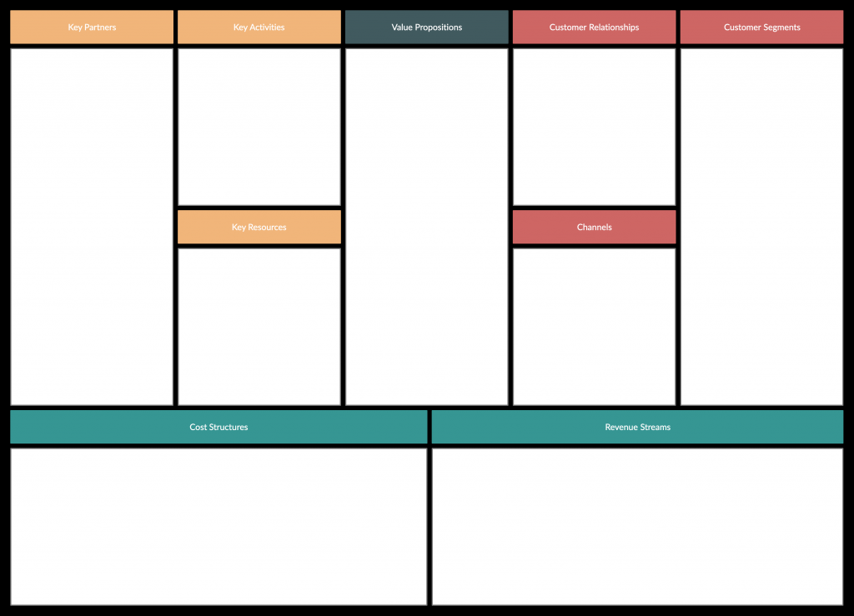
Business Model Canvas
UECS3393 Software Entrepreneurship
UTAR - LKC FES DIECS|

Slide 6
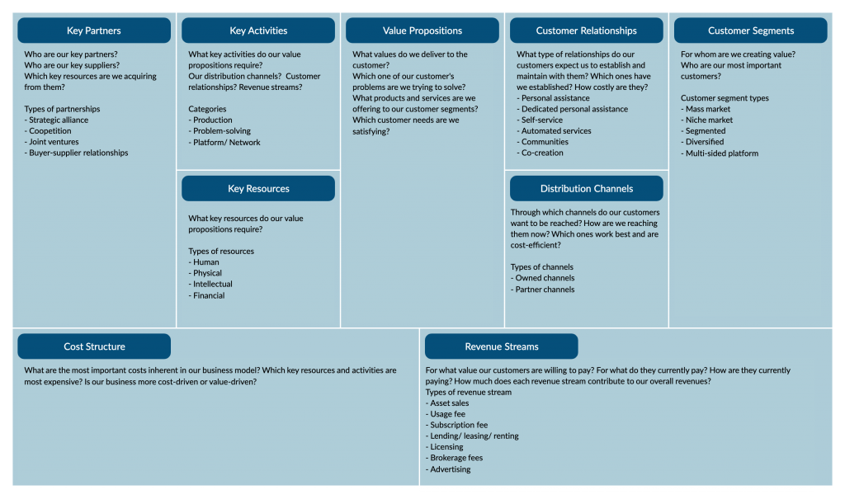
The Business Model Canvas
UECS3393 Software Entrepreneurship
UTAR - LKC FES DIECS|

Slide 7
Customer Segmentation
UECS3393 Software Entrepreneurship
These are the groups of people or companies that you are trying to target and sell your product or service to.
Segmenting your customers based on similarities such as geographical area, gender, age, behaviors, interests, etc. gives you the opportunity to better serve their needs, specifically by customizing the solution you are providing them.
After a thorough analysis of your customer segments, you can determine who you should serve and ignore. Then create customer personas for each of the selected customer segments.
UTAR - LKC FES DIECS|

Slide 8
UECS3393 Software Entrepreneurship
There are different customer segments a business model can target and they are;
Mass market: A business model that focuses on mass markets doesn’t group its customers into segments. Instead, it focuses on the general population or a large group of people with similar needs. For example, a product like a phone.
Niche market: Here the focus is centered on a specific group of people with unique needs and traits. Here the value propositions, distribution channels, and customer relationships should be customized to meet their specific requirements. An example would be buyers of sports shoes.
Segmented: Based on slightly different needs, there could be different groups within the main customer segment. Accordingly, you can create different value propositions, distribution channels, etc. to meet the different needs of these segments.
Diversified: A diversified market segment includes customers with very different needs.
Multi-sided markets: this includes interdependent customer segments. For example, a credit card company caters to both their credit card holders as well as merchants who accept those cards.
UTAR - LKC FES DIECS|

Slide 9
Customer relationships
UECS3393 Software Entrepreneurship
There are several types of customer relationships
Personal assistance: you interact with the customer in person or by email, through phone call or other means.
Dedicated personal assistance: you assign a dedicated customer representative to an individual customer.
Self-service: here you maintain no relationship with the customer, but provides what the customer needs to help themselves.
Automated services: this includes automated processes or machinery that helps customers perform services themselves.
Communities: these include online communities where customers can help each other solve their own problems with regard to the product or service.
Co-creation: here the company allows the customer to get involved in the designing or development of the product. For example, YouTube has given its users the opportunity to create content for its audience.
UTAR - LKC FES DIECS|

Slide 10
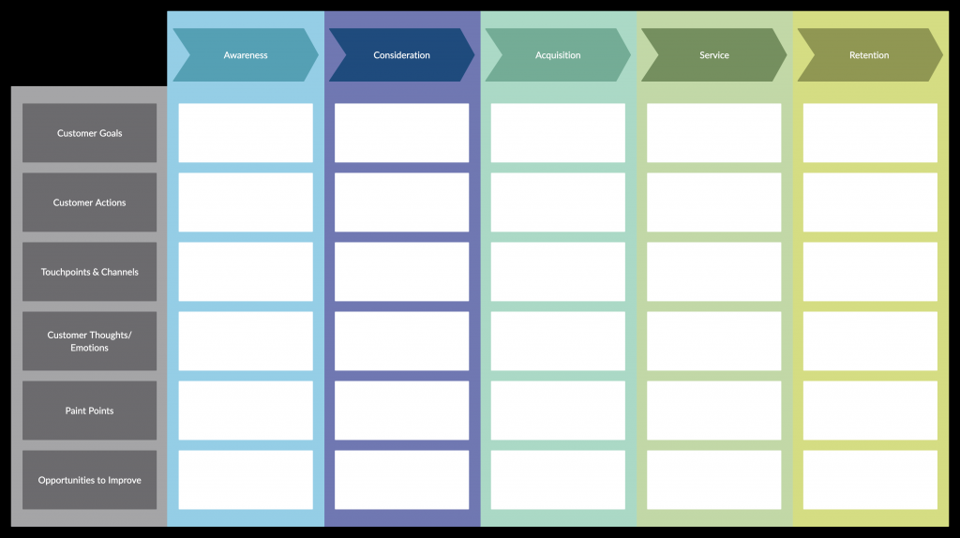
UECS3393 Software Entrepreneurship
You can understand the kind of relationship your customer has with your company through a customer journey map. It will help you identify the different stages your customers go through when interacting with your company. And it will help you make sense of how to acquire, retain and grow your customers.
UTAR - LKC FES DIECS|

Slide 11
Channels
UECS3393 Software Entrepreneurship
This block is to describe how your company will communicate with and reach out to your customers. Channels are the touch points that let your customers connect with your company.
Channels play a role in raising awareness of your product or service among customers and delivering your value propositions to them. Channels can also be used to allow customers the avenue to buy products or services and offer post-purchase support.
There are two types of channels
Owned channels: company website, social media sites, in-house sales, etc.
Partner channels: partner-owned websites, wholesale distribution, retail, etc.
UTAR - LKC FES DIECS|

Slide 12
Revenue streams
UECS3393 Software Entrepreneurship
Revenues streams are the sources from which a company generates money by selling their product or service to the customers. And in this block, you should describe how you will earn revenue from your value propositions.
A revenue stream can belong to one of the following revenue models,
Transaction-based revenue: made from customers who make a one-time payment
Recurring revenue: made from ongoing payments for continuing services or post-sale services
UTAR - LKC FES DIECS|

Slide 13
UECS3393 Software Entrepreneurship
There are several ways you can generate revenue from
Asset sales: by selling the rights of ownership for a product to a buyer
Usage fee: by charging the customer for the use of its product or service
Subscription fee: by charging the customer for using its product regularly and consistently
Lending/ leasing/ renting: the customer pays to get exclusive rights to use an asset for a fixed period of time
Licensing: customer pays to get permission to use the company’s intellectual property
Brokerage fees: revenue generated by acting as an intermediary between two or more parties
Advertising: by charging the customer to advertise a product, service or brand using company platforms
UTAR - LKC FES DIECS|

Slide 14
Key Activities
UECS3393 Software Entrepreneurship
What are the activities/ tasks that need to be completed to fulfill your business purpose? In this section, you should list down all the key activities you need to do to make your business model work.
These key activities should focus on fulfilling its value proposition, reaching customer segments and maintaining customer relationships, and generating revenue.
There are 3 categories of key activities;
Production: designing, manufacturing and delivering a product in significant quantities and/ or of superior quality.
Problem-solving: finding new solutions to individual problems faced by customers.
Platform/ network: Creating and maintaining platforms. For example, Microsoft provides a reliable operating system to support third-party software products.
UTAR - LKC FES DIECS|

Slide 15
Key Resources
UECS3393 Software Entrepreneurship
This is where you list down which key resources or the main inputs you need to carry out your key activities in order to create your value proposition.
There are several types of key resources and they are
Human (employees)
Financial (cash, lines of credit, etc.)
Intellectual (brand, patents, IP, copyright)
Physical (equipment, inventory, buildings)
UTAR - LKC FES DIECS|

Slide 16
Key Partners
UECS3393 Software Entrepreneurship
Key partners are the external companies or suppliers that will help you carry out your key activities. These partnerships are forged in order to reduce risks and acquire resources.
Types of partnerships are
Strategic alliance: partnership between non-competitors
Coopetition: strategic partnership between partners
Joint ventures: partners developing a new business
Buyer-supplier relationships: ensure reliable supplies
UTAR - LKC FES DIECS|

Slide 17
Cost structure
UECS3393 Software Entrepreneurship
In this block, you identify all the costs associated with operating your business model.
You’ll need to focus on evaluating the cost of creating and delivering your value propositions, creating revenue streams, and maintaining customer relationships. And this will be easier to do so once you have defined your key resources, activities, and partners.
Businesses can either be cost-driven (focuses on minimizing costs whenever possible) and value-driven (focuses on providing maximum value to the customer).
UTAR - LKC FES DIECS|

Slide 18
Value propositions
UECS3393 Software Entrepreneurship
This is the building block that is at the heart of the business model canvas. And it represents your unique solution (product or service) for a problem faced by a customer segment, or that creates value for the customer segment.
A value proposition should be unique or should be different from that of your competitors. If you are offering a new product, it should be innovative and disruptive. And if you are offering a product that already exists in the market, it should stand out with new features and attributes.
Value propositions can be either quantitative (price and speed of service) or qualitative (customer experience or design).
UTAR - LKC FES DIECS|

Slide 19
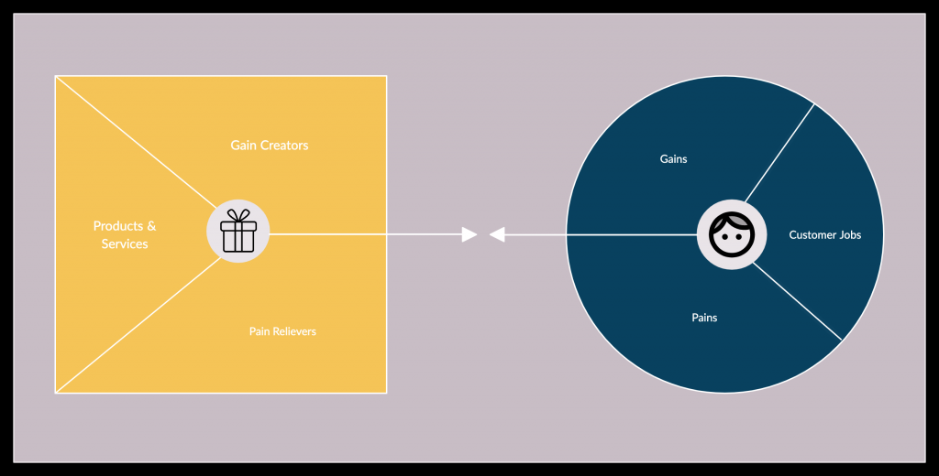
UECS3393 Software Entrepreneurship
UTAR - LKC FES DIECS|

Slide 20
Summary
UECS3393 Software Entrepreneurship
The 9 main building blocks in the business model canvas template:
Key Partners: The strategic relationships your business creates with other companies or people.
Key Activities: Activities or tasks that are integral to operating your company.
Key Resources: Assets that are required to operate and deliver your company’s value proposition.
Value Proposition: The fundamental need that your company is trying to fulfill for its customers. Why your company exists.
Customer Relationships: The type of interactions your company has with its customers and the level of support it gives.
Channels: Different methods that your company uses to deliver its products and value proposition to customers.
Customer Segments: The different groups of customers that your company interacts with.
Cost Structure: How a company spends money on operations. The key costs and level of cost-focus for your company.
Revenue Streams: Your company’s sources of cash flows.
UTAR - Faculty of Information & Communication Technology |

Slide 21
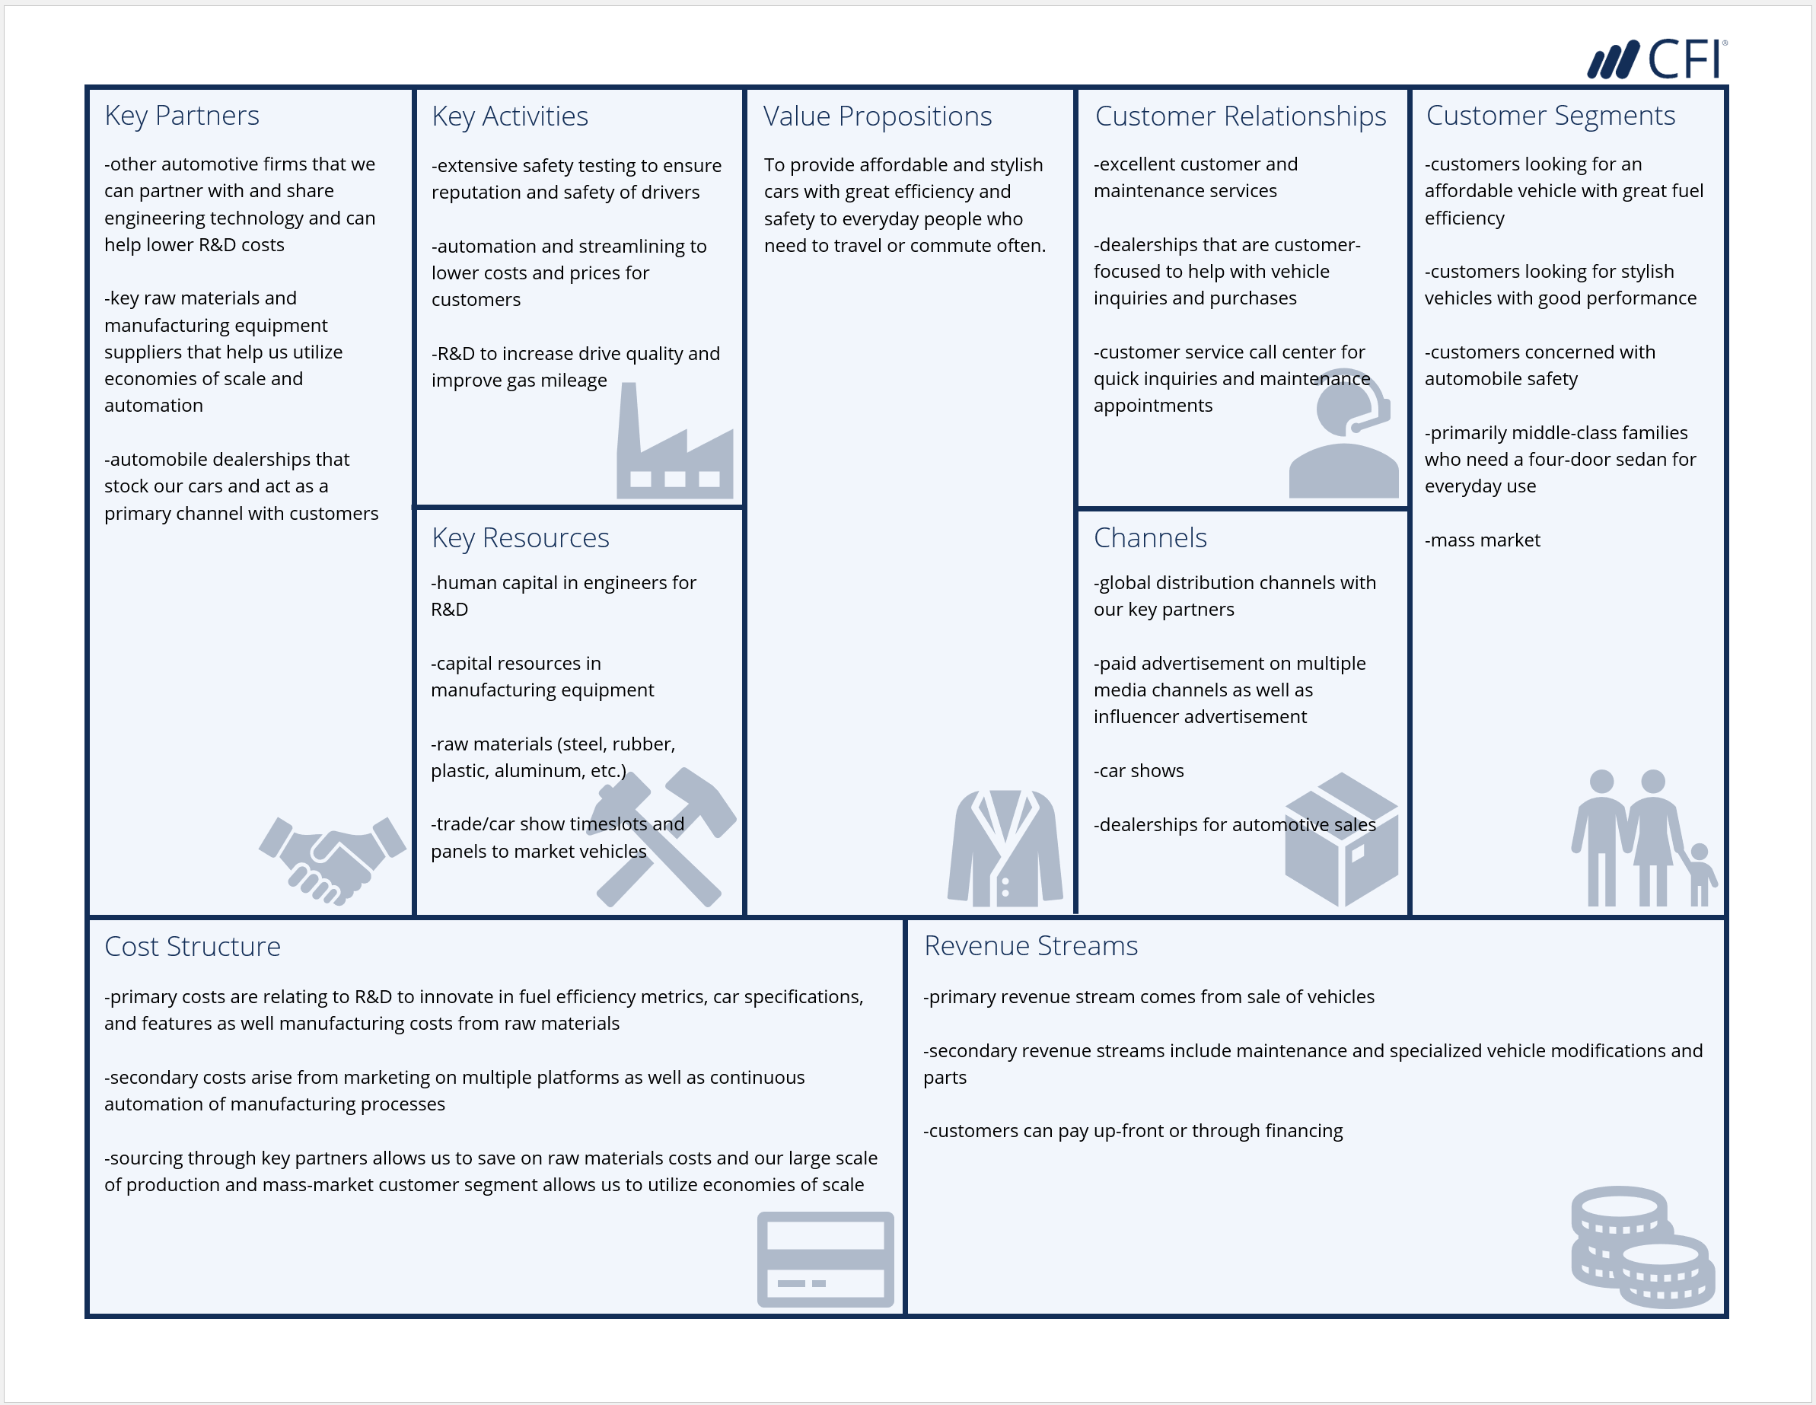
Examples
UECS3393 Software Entrepreneurship
UTAR - Faculty of Information & Communication Technology |

